Slide 1
System Identification with Kalman Filters
Norwegian University of Science and Technology
Adrian Langmo, Giacomo Gardella, Terje Haughland, Daniel Centurion Barrionuevo, Erik Odinsen, Muhammad Hilmi

Slide 2
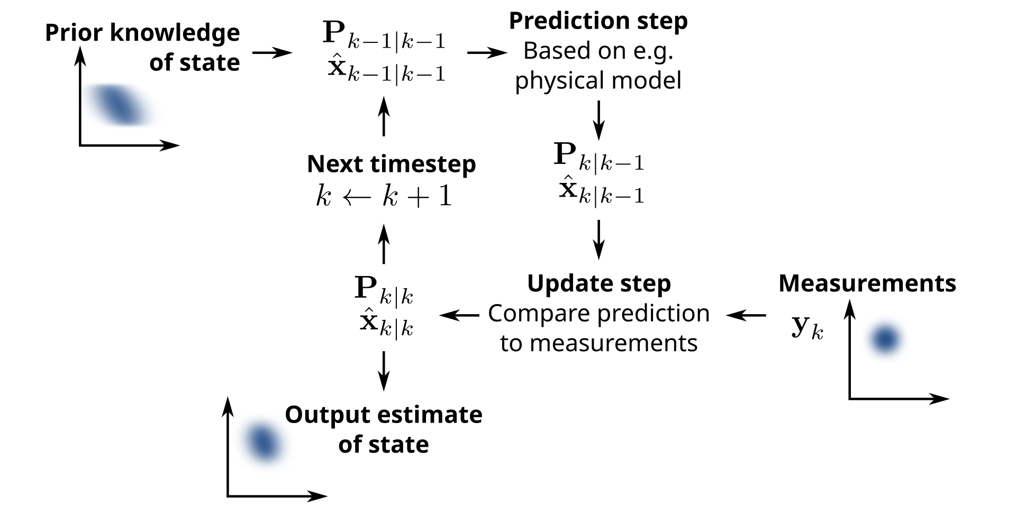
Kalman Filters
Gain
Error covariance
State

Slide 3

Examples
Take an ARX model:
y output, u input, v noise, and k time step.
→ Estimate parameters a and b

Slide 4

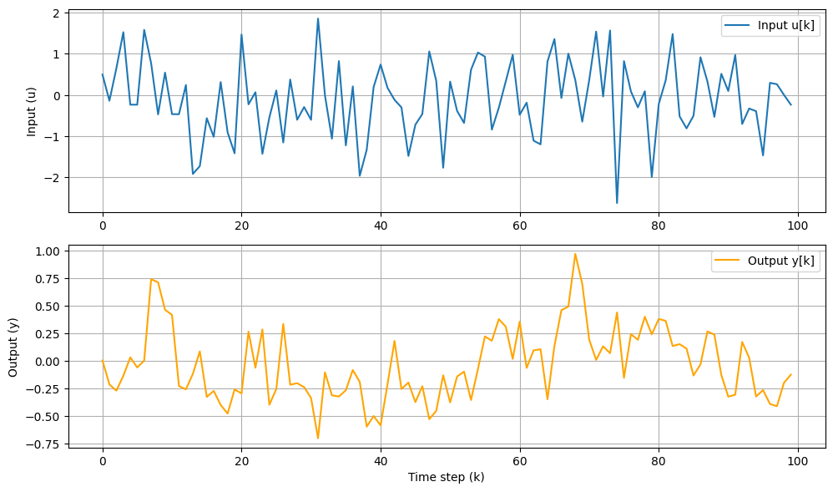

Slide 5
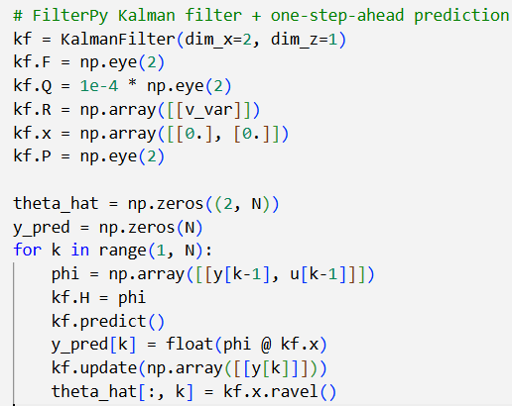
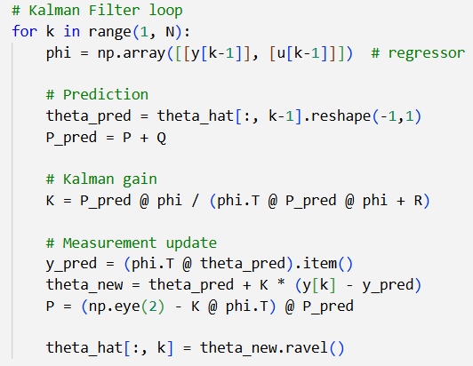
from filterpy.kalman import KalmanFilter
Equations
OR

Slide 6
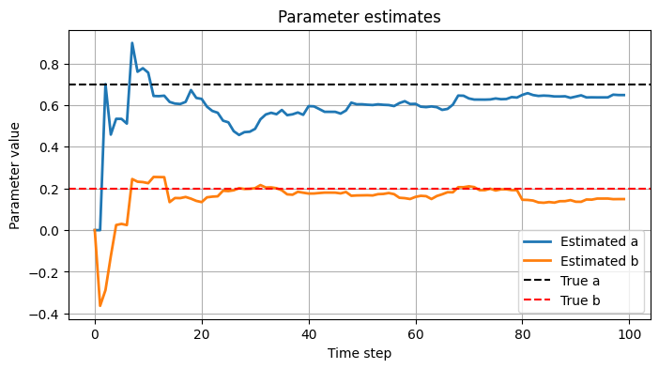

Slide 7
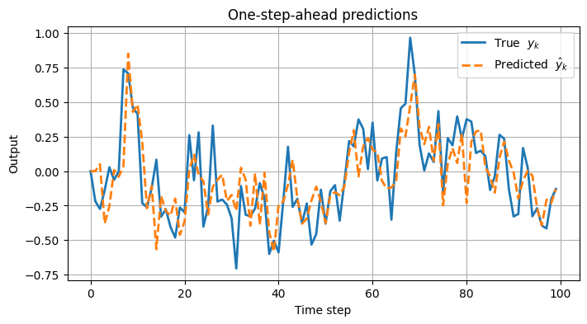

Slide 8

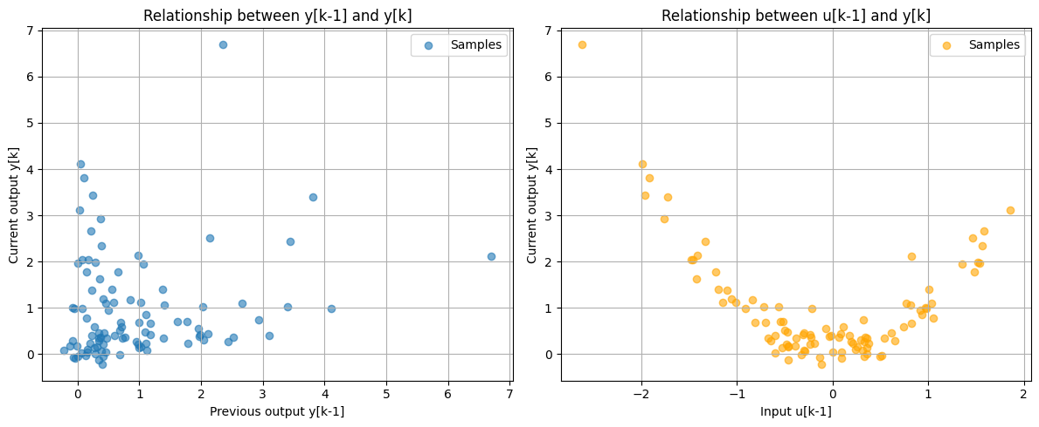
Nonlinear

Slide 9
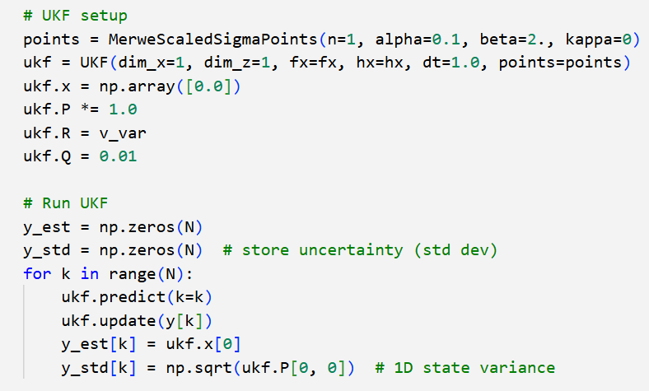

Slide 10
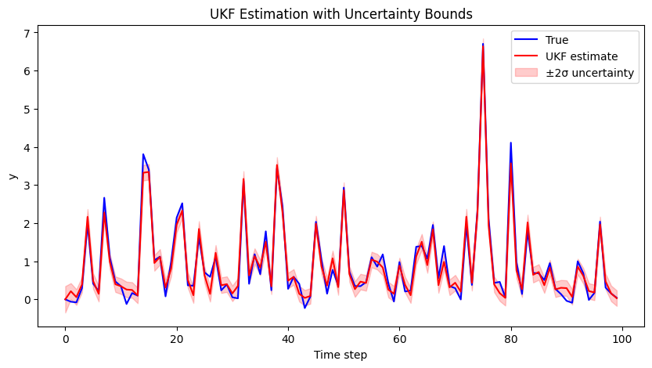

Slide 11
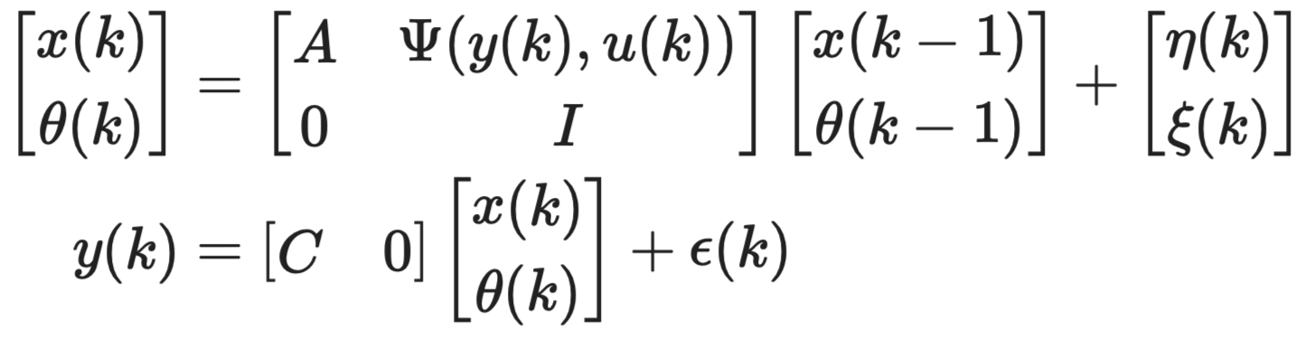
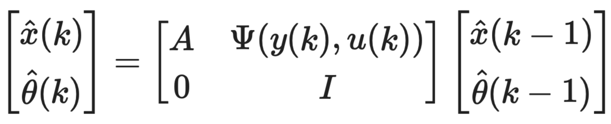
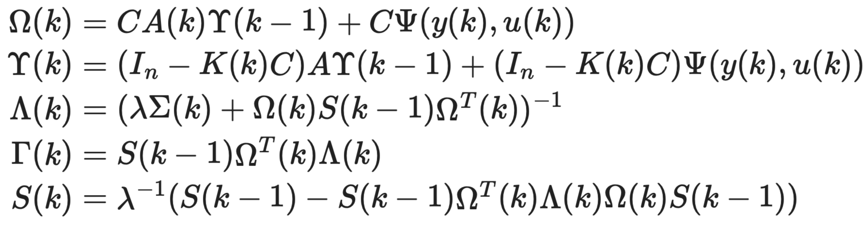
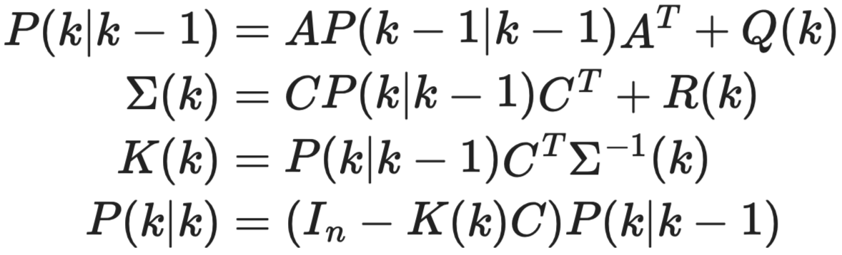
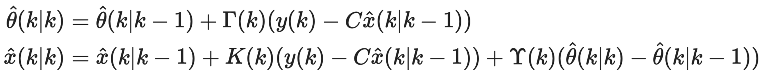
Joint Estimation
Augmented system dynamics
Priori estimation (prediction)
Kalman filter
RLS-like
Posteriori estimation (update)
Zhang, Q. (2018). Adaptive Kalman filter for actuator fault diagnosis. Automatica, 93, 333-342

Slide 12
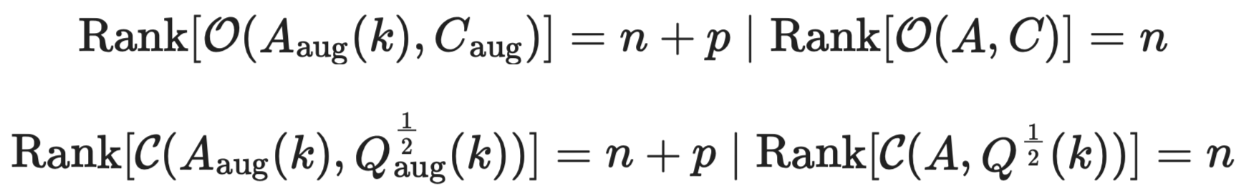
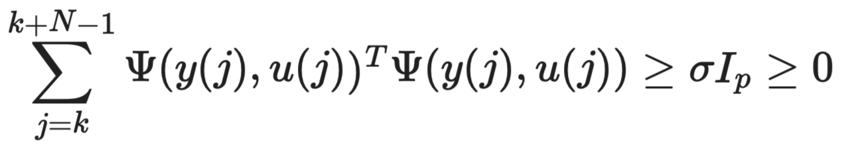
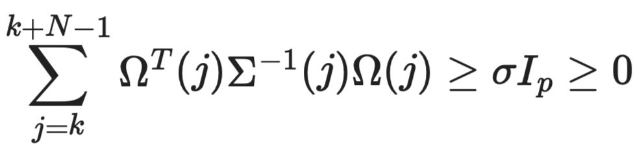
Why?
Augmented estimation:
Joint estimation:
Observability
Observability
Controllability
Controllability
Persistent excitation
Persistent excitation
M. Hilmi, A. Hasan and M. A. Lundteigen, "Self-Tuning Kalman Filter for Fault Estimation of Nonlinear Systems," in the 64th IEEE Conference on Decision and Control (CDC), Rio de Janeiro, Brazil, 2025.

Slide 13
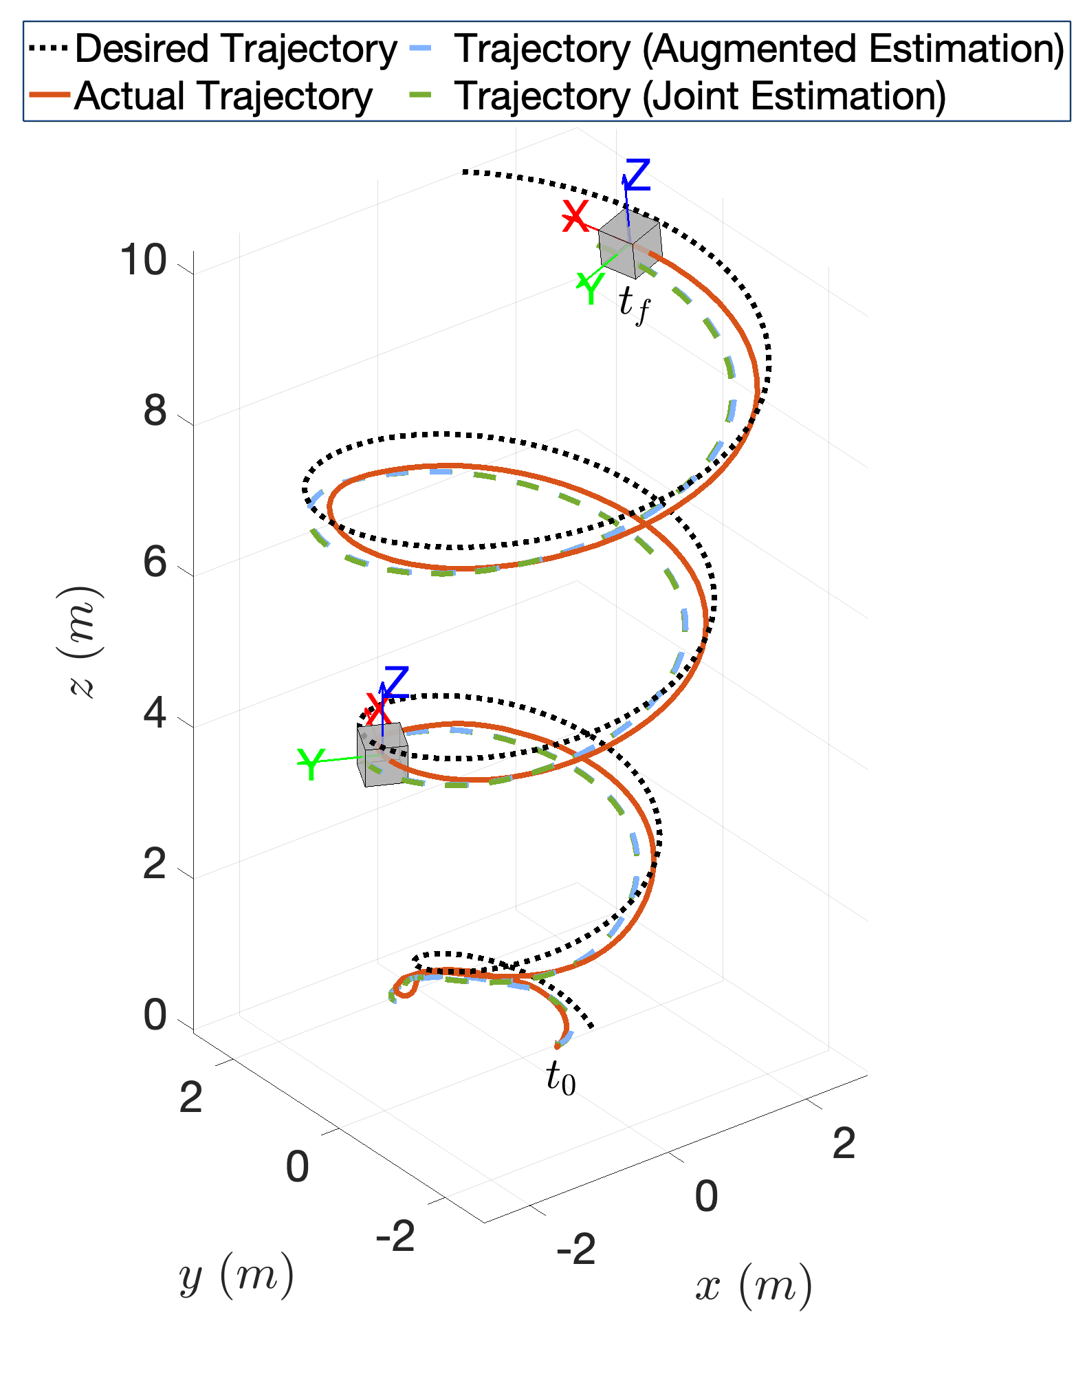
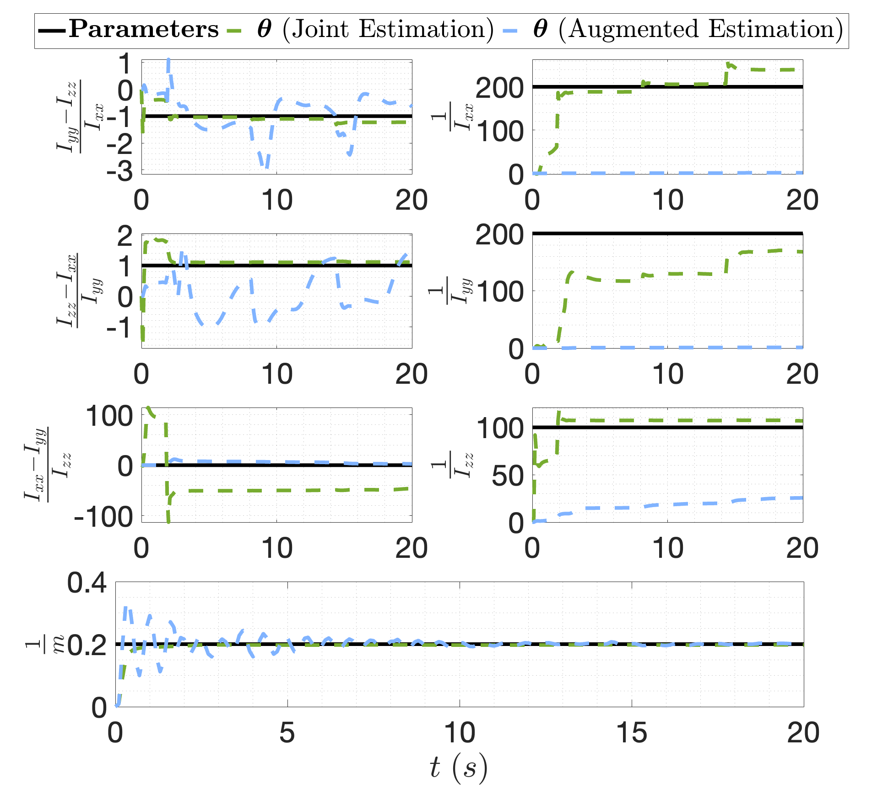
WyNDA Example
Library functions
https://github.com/hilmi-ica/WyNDA-UAV.git
M. Hilmi, S. F. Ramadhan, A. Widyotriatmo an A. Hasan, "Real-Time Parameter Estimation for Digital Twins of Unmanned Aerial Vehicles," in IEEE Transactions on Intelligent Vehicles, 2025 [Submitted].

